Slide 1
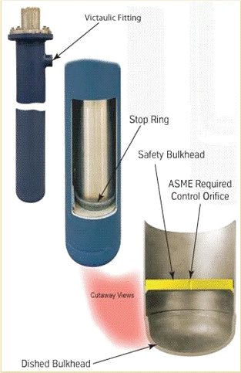
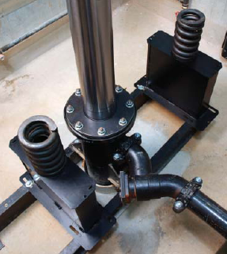
Jacks Express
Tutorial for Estimating,
Surveying, and Ordering
Estimating, Surveying and Ordering Made Easy

Slide 2
Jacks Express
The Jacks Express program is designed for single bearing conventional jacks ranging from 3S to 10S in size.
3S - 7S jacks are available in both standard and heavy wall applications.
8S - 10S jacks are available in standard wall applications only.
The situations listed below are not applicable with the Jacks Express program. Please contact our Sales Response Team at SRT@tkelevator.com with questions.
Extra Heavy wall jacks
Heavy wall 8S - 10S jacks
Larger Jacks (12S & larger)
Telescoping Jacks
Double Bearing Jacks
C-2 Loading

Slide 3
Jacks Express
We designed this program with you in mind!
Estimating replacement jacks is quick and simple, with simplified surveying and ordering.
With minimal information you can have estimates in moments, not hours or days.
This program provides you with a printable survey tool you can take to the jobsite.

Slide 4
Jacks Express
Getting Started!
Step 1 – Open a new document, located at http://www.verticalxpress.com/express/ , each time you estimate a new job (make sure you are logged in to your account). This will ensure you have the latest version and current pricing.
*Tip: Make sure to maximize your spreadsheet to ensure you see all tabs.
Step 2 – Save the document to your computer! Using job name
and number in the file name will help keep your files organized.

Slide 5
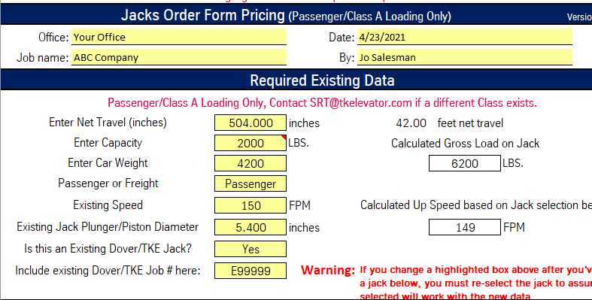
Jacks Express
To get a quote, complete all fields in yellow under both Jacks Express Pricing and Required Existing Data Headings.
Make sure all Required Existing Data is correct & accurate.
Do not guess at Existing Jack Diameter! Accuracy is critical to determine which jacks are available for your application.

Slide 6
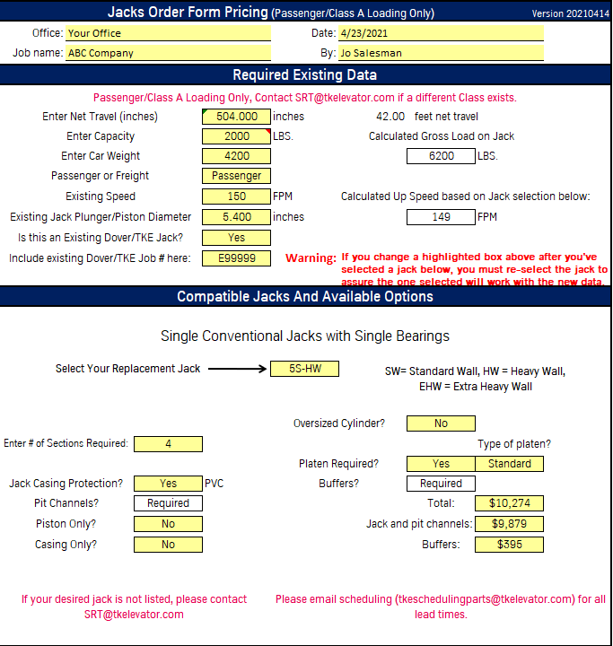
Jacks Express
Under the Compatible Jacks and Available Options section, click the yellow box labeled, Select Your Replacement Jack, and choose the appropriate jack for your application.
*Tip: To determine the jack that best fits your needs you need to consider the following: size / diameter of existing hole, speed requirements, and power unit limitations.
As you select different jacks you will see that price and calculated up speed will change accordingly.
This will give you the jack price only!
Select the # of Sections Required and desired options under Compatible Jacks And Available Options Header. As you update each of these your pricing may change.

Slide 7
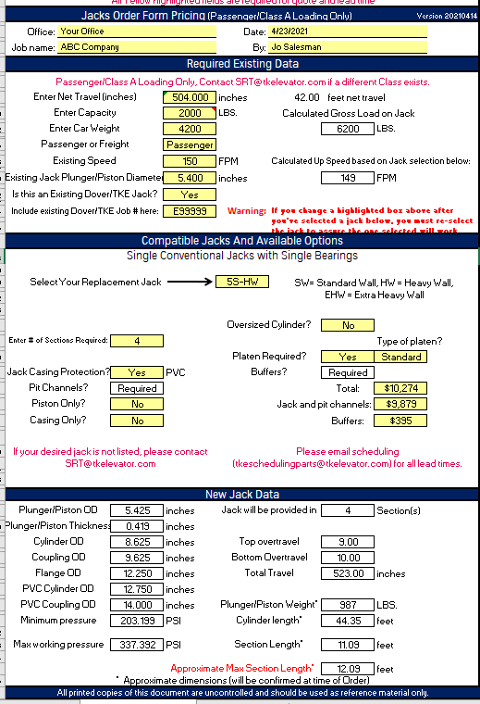
Jacks Express
Congratulations! You completed the Jacks Express estimate.
Prior to completing and providing your customer a quote, review each section of the estimate completely!
Sell the Job!

Slide 8
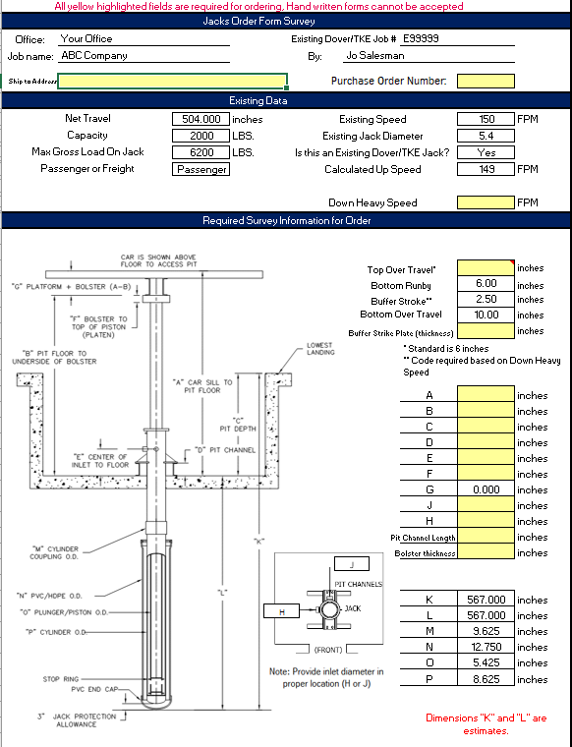
Jacks Express
Congratulations! You sold the job!
One more step:
Print the Survey Form (2nd tab) and take it with
you to the jobsite.
Survey the job.
Update the excel file with the survey data All yellow fields are required. *Handwritten order forms cannot be accepted
NOTE: many of the fields auto populate from the Estimating Form.
Accuracy is critical to ensure your jack is designed and built to fit your needs.

Slide 9
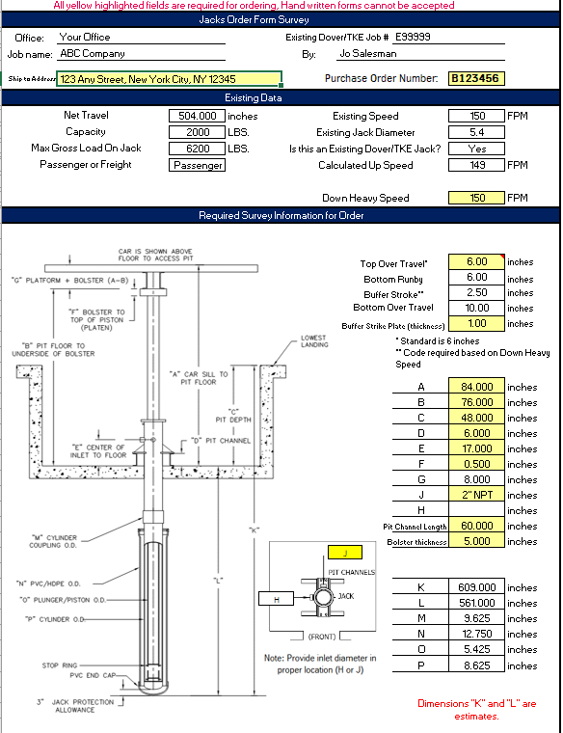
Jacks Express
You are almost complete!
Save the file and e-mail it to OrderIntakeMFG@tkelevator.com
You will receive a response informing you that your order has been received and is being processed.
If you have questions call: (844) 853-7781

