Slide 1
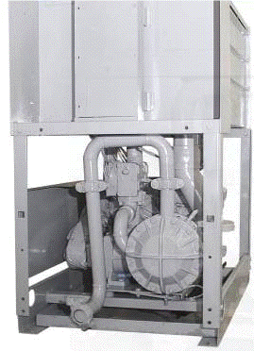
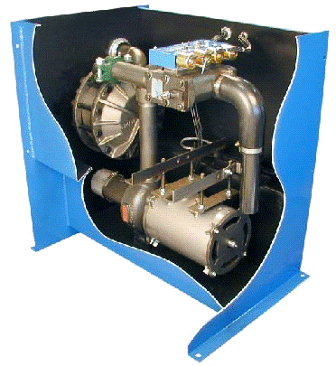
Power Units Express
Tutorial for Estimating,
Surveying, and Ordering
AP POWER UNIT
EP POWER UNIT
Estimating and Ordering
Made Simple

Slide 2
Power Units Express
We designed this program with you in mind!
Estimating replacement power units quick, simple and electronically.
With minimal information you can have an estimate in moments, not
hours or days.

Slide 3
Power Units Express
Getting Started!
Step 1 – Open a new document, located at http://www.verticalxpress.com/express/ , each time you estimate a new job (make sure you are logged in to your account). This will ensure you have the latest version and current pricing.
*Tip: Make sure to maximize your spreadsheet to ensure you see all tabs.
Step 2 – Save the document to your computer! Using job name and number in the file name will help keep your files organized.

Slide 4
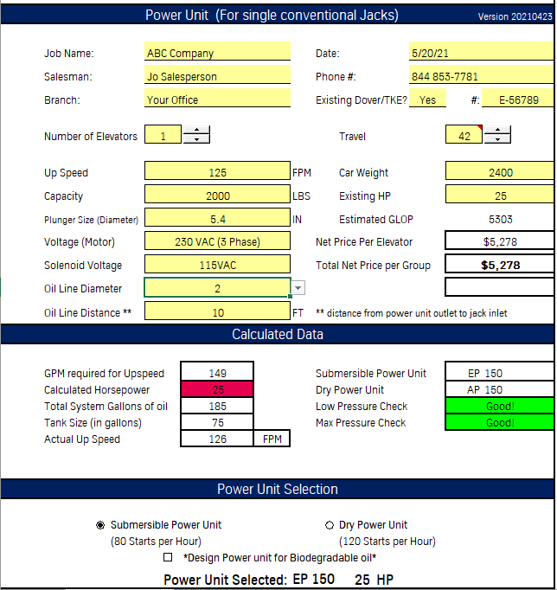
Power Units Express
To get a quote you start by completing all fields in
yellow.
Fill in all of the yellow fields in the Power Units Express section of the estimating form completely and accurately.
Do not guess! Jack Piston Diameter, Travel, Car Weight, Existing HP, Up Speed, and Capacity information must be correct. Accuracy is critical to determine which power units are available for your applications.
Under the Power Unit Selection heading select either submersible (EP) or dry (AP.)
There may be applications where you only get one option, either EP or AP. However, usually you will get to choice of EP or AP.
After entering the required data, review the Calculated Data, and any notes that appear. Make sure speed, HP, and GPM work for the job you are estimating.

Slide 5
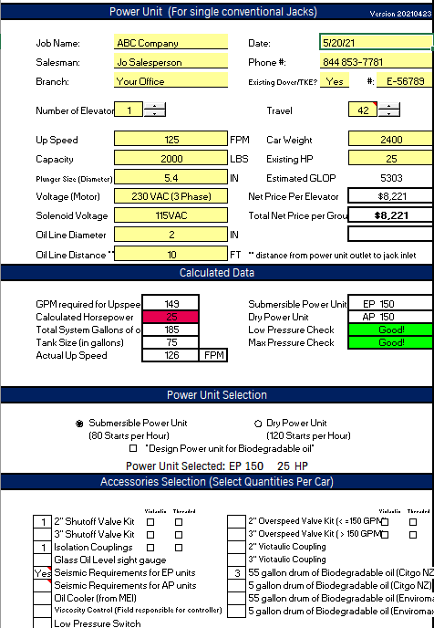
Power Units Express
Select the appropriate accessories required for your specific job. Accessories should be selected per car.
* Tip: Make sure to select threaded or Victaulic for valves.
Each accessory selected will change the price.
Prior to completing and providing to your customer you should review for completeness and accuracy.
Sell the Job!

Slide 6
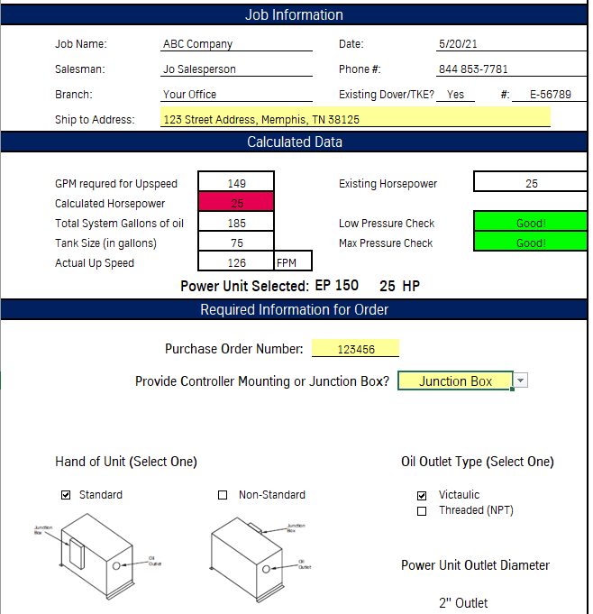
Power Units Express
Congratulations! You sold the job!
You are almost complete!
Go to the Order Form (2nd tab).
Enter the ship to address
Select Controller Mounting (and type of controller) or Junction Box.
Select Hand of Unit – Standard or Non-Standard (See diagram)
Select the oil line type – Victaulic or Threaded
Enter your Purchase Order / PO #
Save the file and e-mail to OrderIntakeMFG@tkelevator.com
Congratulations! You have completed the process!
You will receive a reply letting you know your order has been received and is being processed.

